Slide 1
Autoimmune Diseases
Finding Commonality between Celiac, Crohn’s, Hashimoto’s Thyroiditis and Eczema

Slide 2
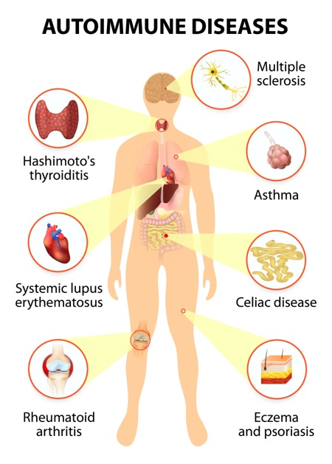
Background Autoimmune diseases
Body attacks own healthy cells
Caused by overactivity in the immune system
Common examples: Rheumatoid arthritis, lupus, IBD, MS, Type 1 diabetes
Often linked to inflammation
Not very well understood
Can run in family
Can be triggered by environmental factors including stress
Notes:
Ellie

Slide 3
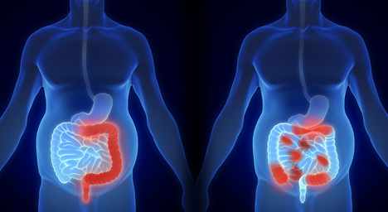
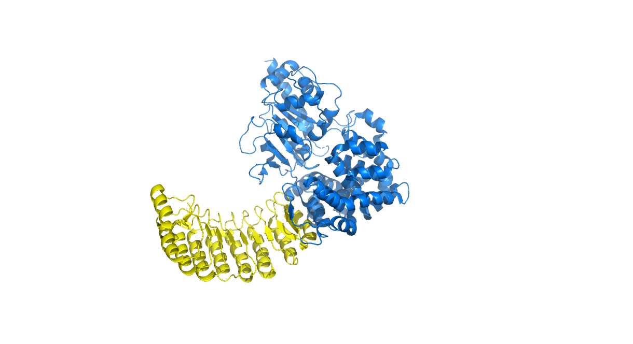
Background Crohn’s
Inflammatory Bowel Disease
Affects entire digestive tract
Abdominal cramping
Diarrhea
Fever
Bowel obstruction
NOD2 gene mutation
Sustained mucosal immune response

Slide 4
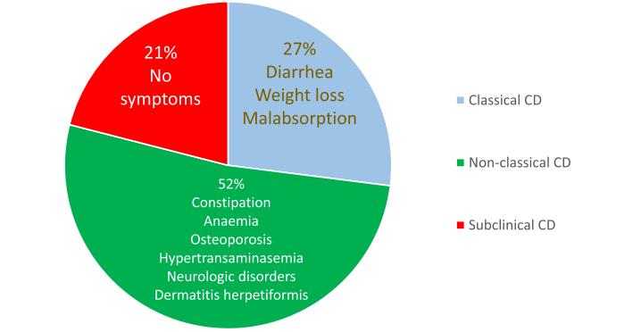
Background Celiac
Immune system damages small intestine, increasing gut permeability
Gluten is an environmental trigger
Only seen in people who can express HLA-DQ2/HLA-DQ8
Human leukocyte antigen proteins, responsible for presenting antigens in immune response

Slide 5
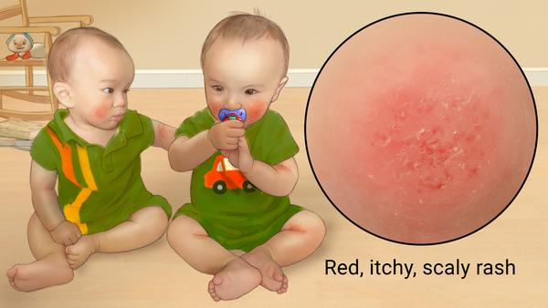
Background Eczema
Very Common
Complex Disease
Genetic and Environmental
Usually starts in early childhood

Slide 6
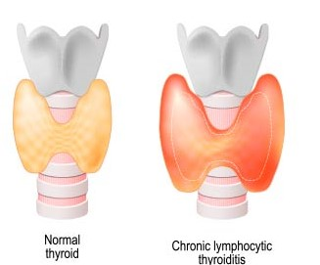
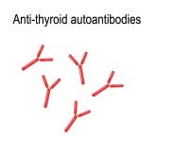
Background Hashimoto’s Thyroiditis
The body attacks the thyroid
Much more common in women
Later diagnosis
Symptoms: enlarged thyroid gland, depression, weight gain, dry skin or hair
Known pathways affected: immune, apoptotic, metabolism, and GPCR receptor signaling

Slide 7



Research Question
Identify genetic commonality between these four diseases
Analyze commonly associated genes
Look for significant genes through gene expression
Pathway Analysis
Notes:
Tyler

Slide 8
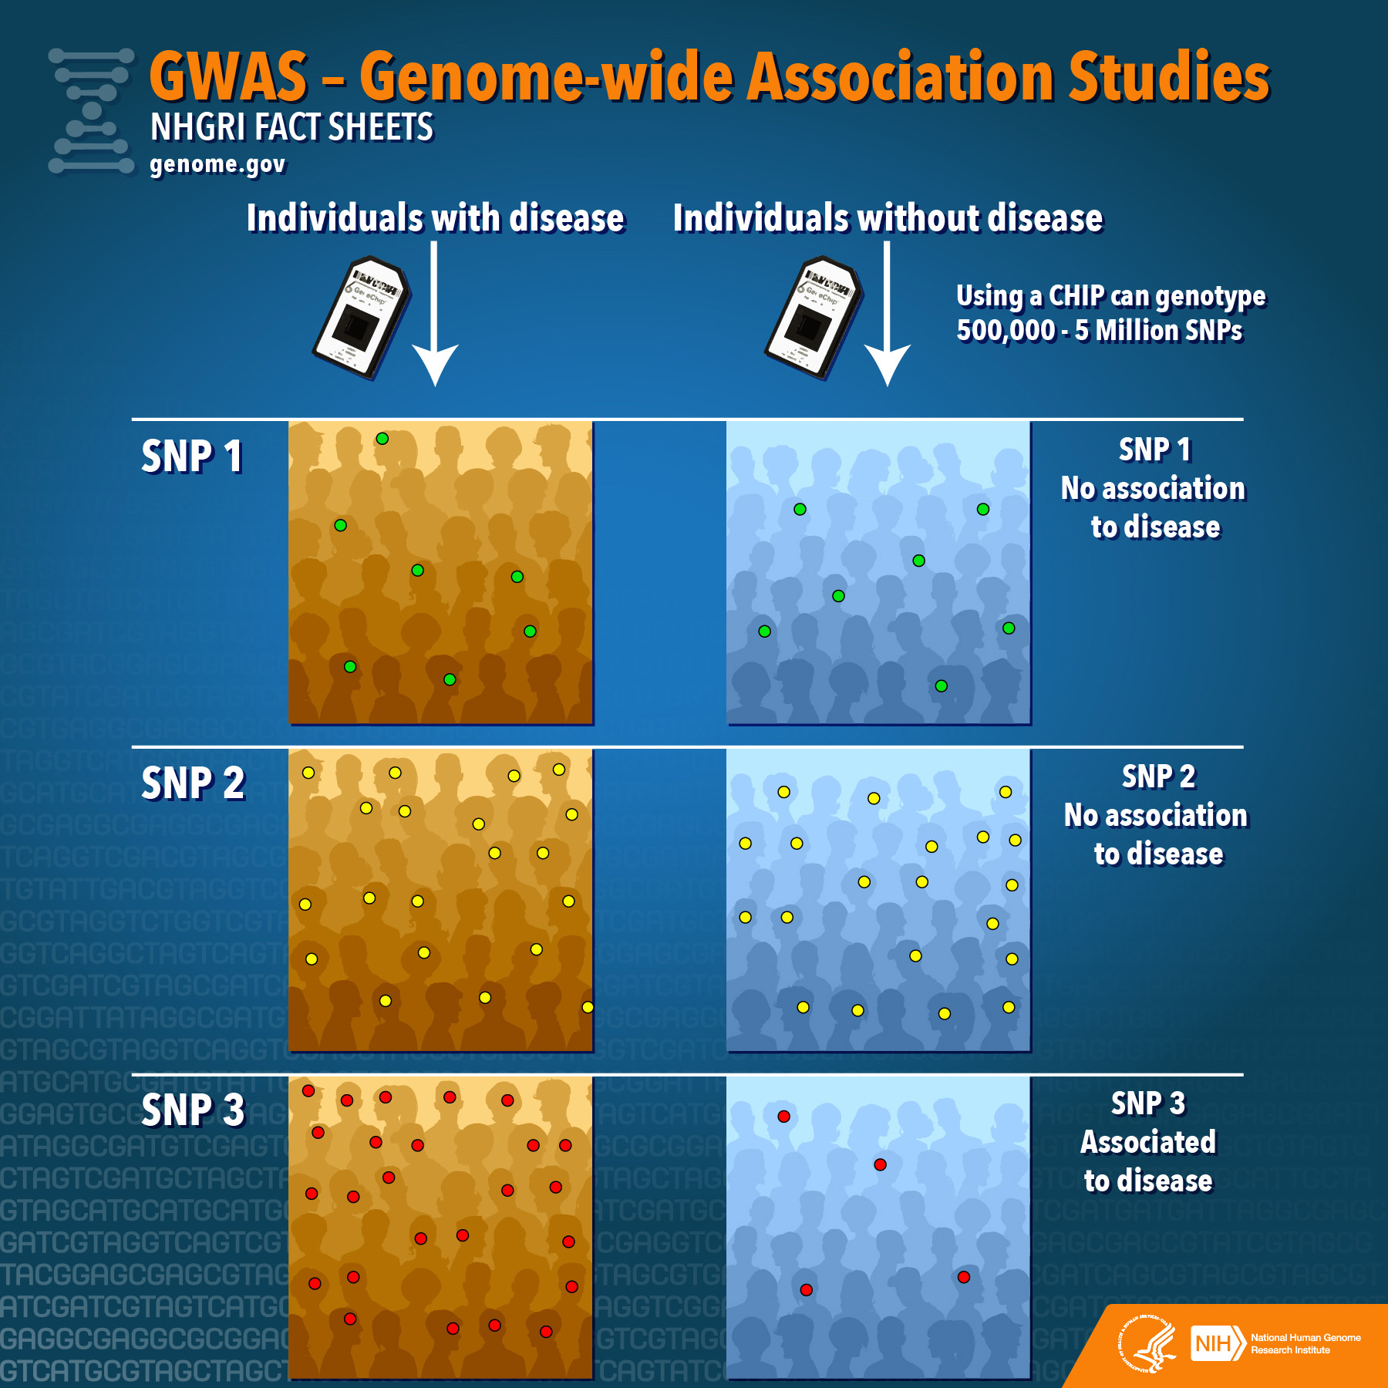
GWAS and ClinVar
GWAS
Control groups Vs Experimental
Identify SNPs that are more common in experimental group
Link risk genes to common SNPs
ClinVar
Archive of reports of relationships between human variation and phenotypes
Submissions with variants found in patient samples
Notes:
Aaron methods, background

Slide 9
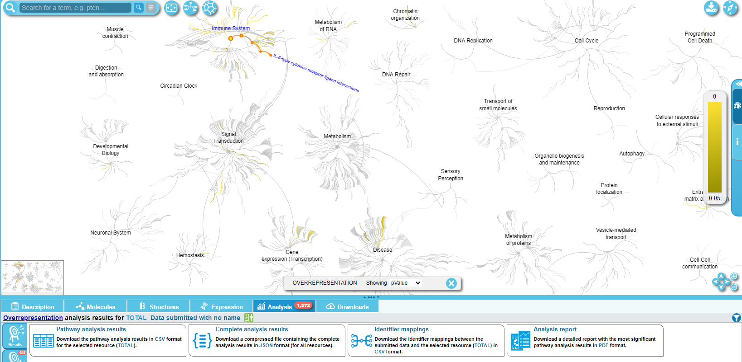
Analysis with Reactome
Pathway Analysis
View Pathways most related to given genes
Input: List of genes
Output: Most significant pathways
Notes:
Tyler

Slide 10
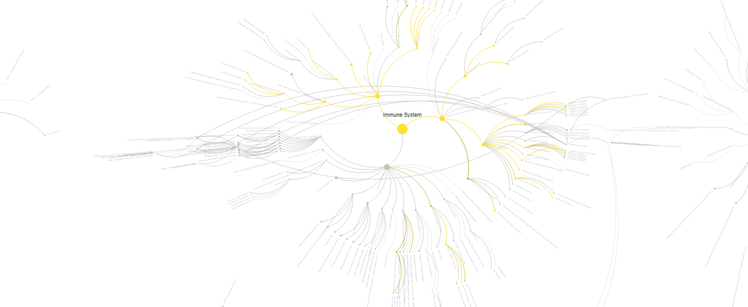
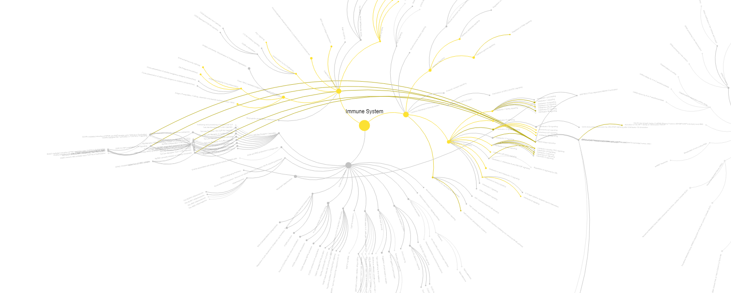
Analysis with Reactome
Eczema
Crohns

Slide 11
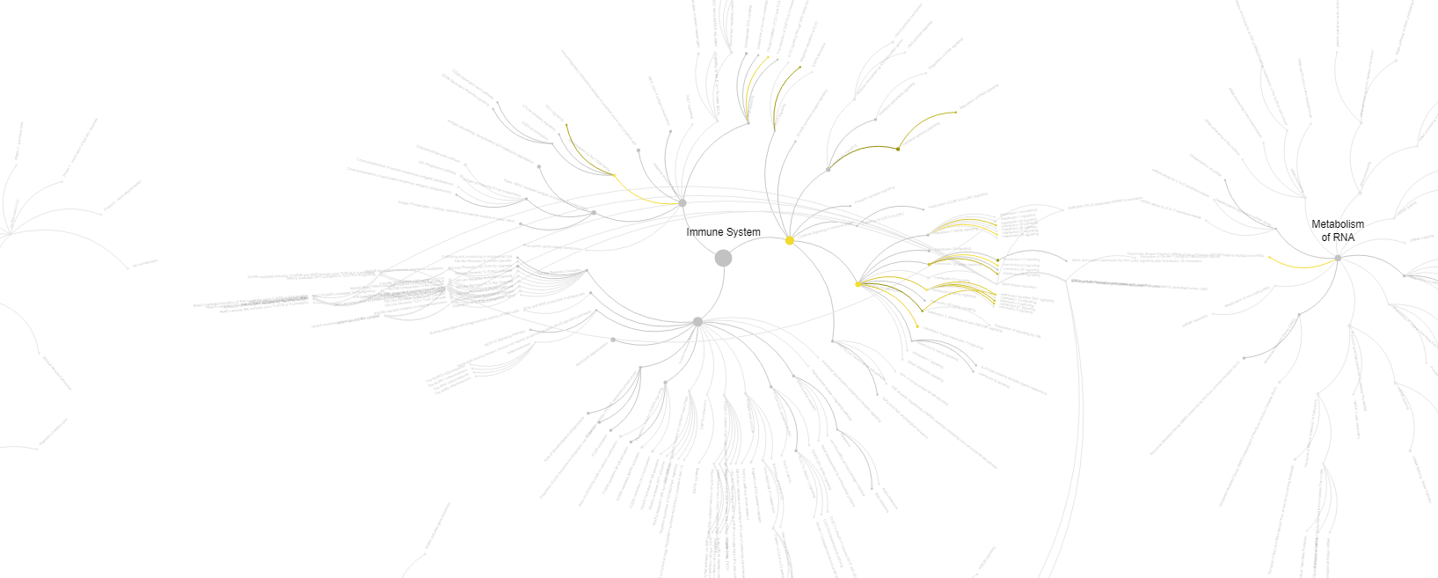
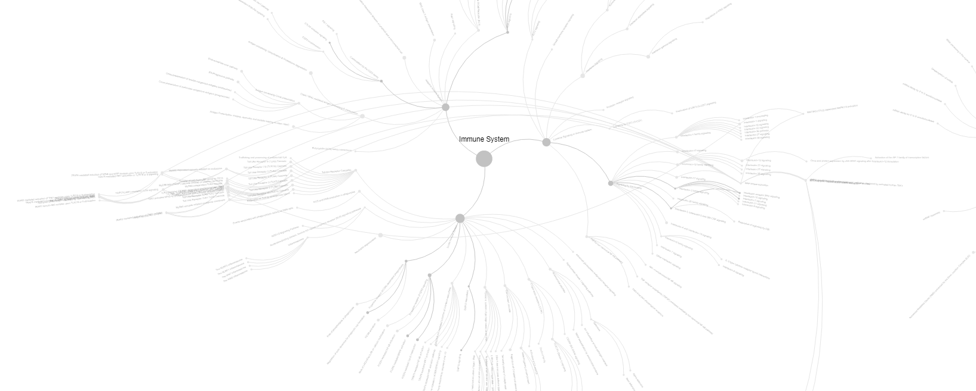
Analysis with Reactome
Celiac
Hashimoto

Slide 12
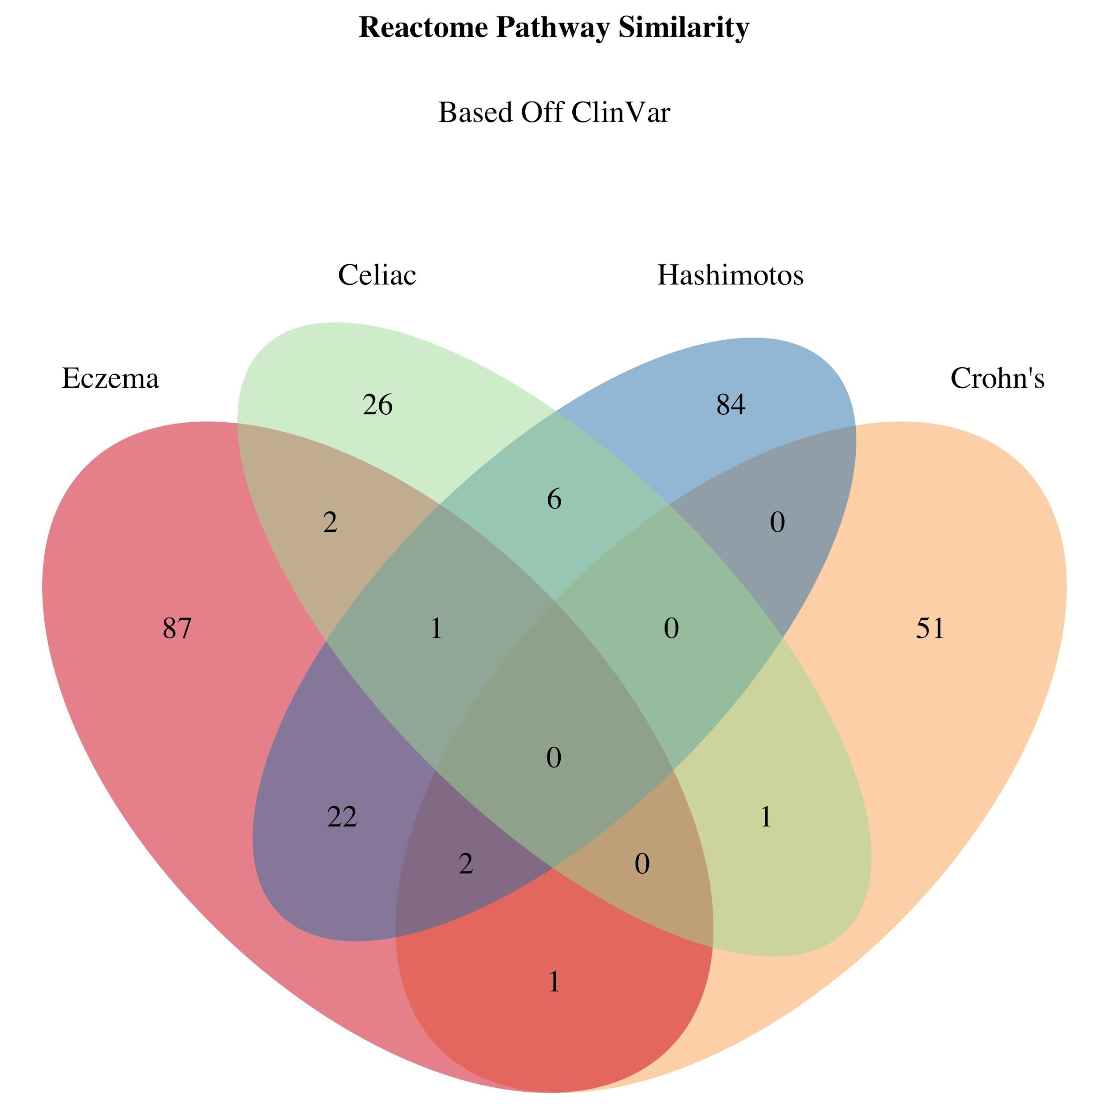
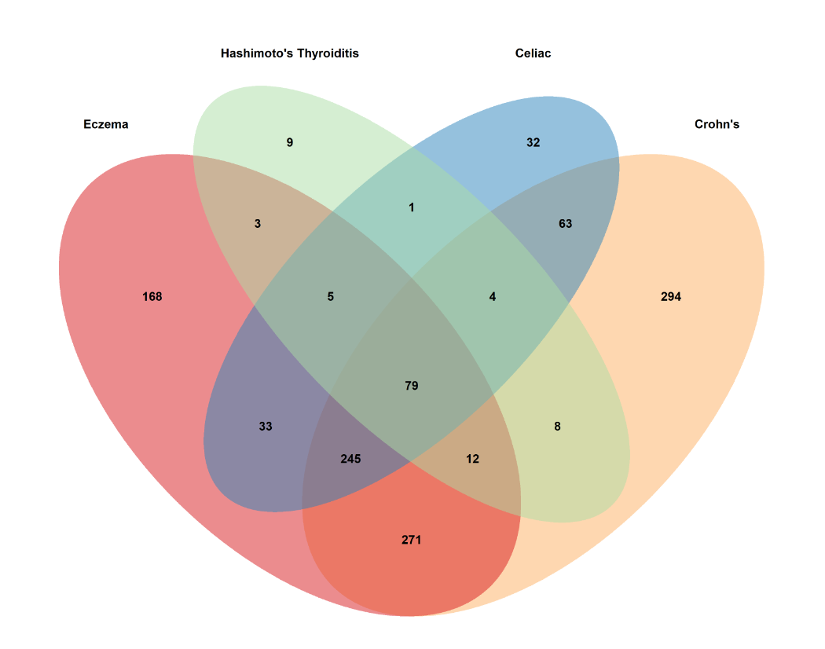
Results of GWAS and ClinVar analysis
GWAS Pathway Similarity
Notes:
Aaron

Slide 13
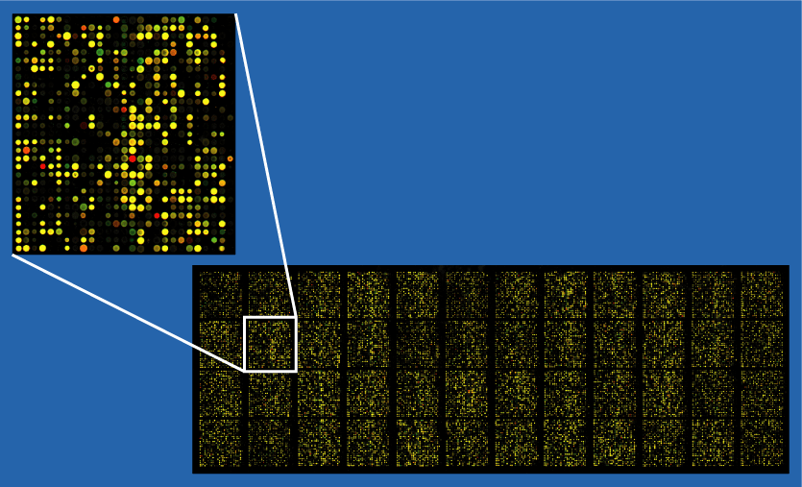
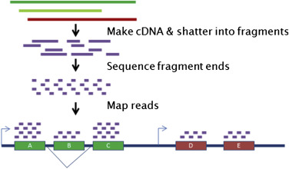
Gene Expression
Can be measured with either microarrays or with RNA-seq
Microarrays
Known sequences used to map DNA fragments and show expression of different genes
DNA fragmented by endonucleases
Fluorescent markers react to probes
RNA-seq
Show the presence and quantity of RNA
Break into small parts
Sequence fragments
Map to DNA

Slide 14
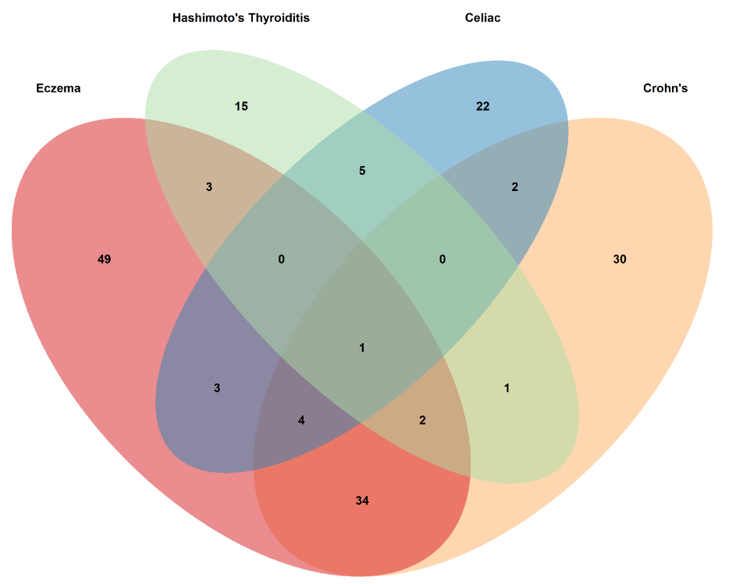
Gene Expression Results
Combined genes from GWAS, ClinVar and MicroArray Studies for pathway analysis
One Significant Common Pathway
RUNX1 and FOXP3 control the development of regulatory T lymphocytes (Tregs)
Notes:
Tyler

Slide 15
Conclusion
Some general similarity between the diseases, but very little specific similarity for all of them.
RUNX1 and FOXP3 regulatory pathway is involved in all four diseases
Hashimoto’s Thyroiditis does not have nearly as much information as the rest of the diseases which make it difficult to compare them well.
Follow up analysis could yield more results

Slide 16
Follow Up Questions
Autoimmune diseases and cancer
RNA-seq data instead of just microarray data
Pull data from many more studies

